Slide 1
Strategic Tic Tac Toe
Team Awesome

Slide 2
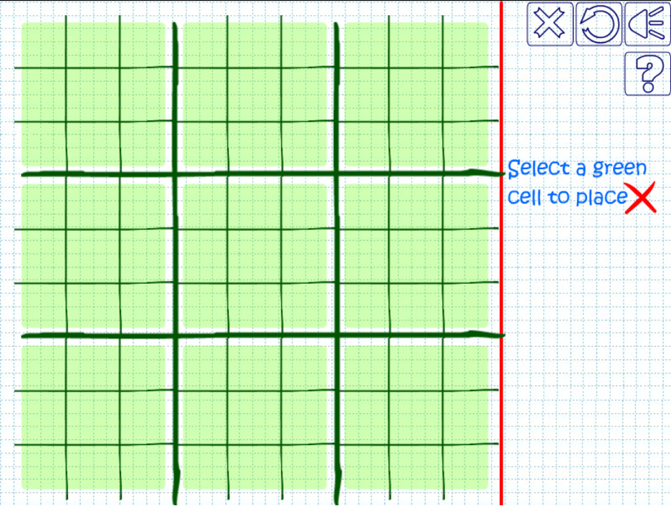
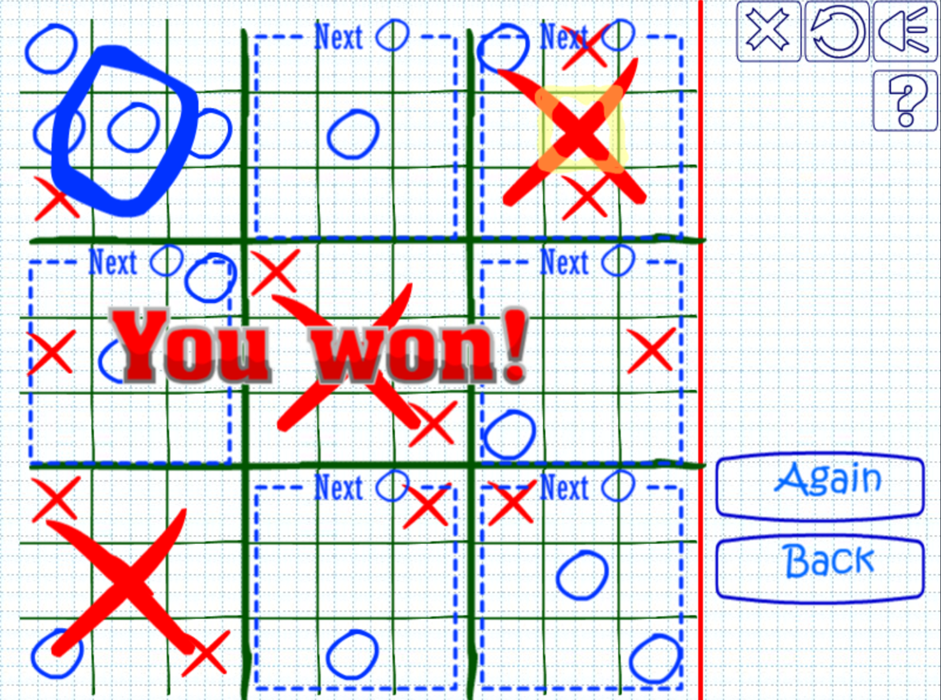
Overview of Game
Notes:
Type of game (why), how it work, basic how to play

Slide 3
Our game demo
Photo of display here

Slide 4
Current Implementation
Playable game
Two Player
Basic Menu

Slide 5
Future implementation(s)
Animations
Multiple saves
Single Player
Fine tuned display
How to play
Board highlights (current square and next one if spot is picked)

Slide 6
What worked
Intuitiveness
Win conditions
Simple controls
Jumping boards
Save/Load with characters

Slide 7
What didn’t
GameBoard -> TicTacBoard
Saving objects to file
Colors in display

Slide 8
Obstacles
Displaying idk what went wrong (colors, rectangles, highlighting one square, ect)
Segmentation Fault
Saving/load game
Where to use polymorphism (after gameboard -> ticTacBoard failed)
Ubuntu (Jacob) (Yeah it was pretty bad)

